Slide 1
Learning & Development Enabling development, Impacting growth…
Apache Spark

Slide 2
Introduction to Spark
What is In-Memory Computing
Real Time Processing
Storm & Kafka
What is Spark
History of Spark
Spark Architecture
Spark Shell
Spark Context
Q&A

Slide 3
In-memory Computing
Processing in memory is one approach to overcoming the von Neumann bottleneck, which is a limitation on throughput caused by the latency inherent in the standard computer architecture.
In-memory computing primarily relies on keeping data in a server's RAM as a means of processing at faster speeds
In-memory computing especially applies to processing problems that require extensive access to data –analytics, reporting or data warehousing, and big data applications.

Slide 4
Benefits of In-memory computing
Better, faster, decision making.
Ability to reduce cost.
Identify competitive opportunities,.
Grow revenue
More efficient application
Reduce risk.
It’s best suited for performing real-time analytics, and developing and deploying real-time applications
In-memory Computing Imperative:
Avoid movement of detailed data.
Calculate first, then move the results

Slide 5
Challenges with in-memory processing
There are some complexities, such as recoverability, that must be dealt with when the system is entirely in memory.
Without creating a copy of the transaction somewhere other than in the memory of the affected system, you can’t recover the transaction and therefore cannot provide durability.
So pure in-memory systems are not ACID complaint.
Much more expensive than spinning disk
columnar representation because it offers a compact representation of the data

Slide 6
Introduction to Spark
What is In-Memory Computing
Real Time Processing
What is Spark
History of Spark
Spark Architecture
Spark Shell
Spark Context
Q&A

Slide 7
Real Time Processing - Few Definitions
Macro batch -Anything over 15 minutes to hours, or even a daily job
Micro batch -Normally something that is fired off every 2 minutes or so, but no more than 15 minutes in total.
Near-Real-Time Decision Support-Considered to be “immediately actionable” by the recipient of the information, with data delivered in less than 2 minutes but greater than 2 seconds.
Near-Real-Time Event Processing-Considered under 2 seconds but can be as fast as a 100-millisecond range
Real Time-Has many definitions. For purposes of this session, consider it anything under 100 milliseconds

Slide 8
Real Time Processing
Processing the data as it arrives, rather than through batch processing.
Commonly referred as stream processing.
Stream processing tools include systems like Apache Storm, Apache Spark Streaming, Apache Samza, or even Apache Flume via Flume interceptors.
These flows will process data as long as they remain running, as opposed to a batch process that operates on a fixed set of data.

Slide 9
Few Examples
Analyzing social media feeds for detecting trends in updates from users of a social media site.
Analyzing financial feeds for anomaly detection in a user’s account activity.
Analyzing machine data feeds for raising alerts in the case of anomalies or errors in application logs.

Slide 10
Near-real-time processing tools
Impala
Impala
Impala
Map Reduce
Flume Interceptors
Spark Streaming
Spark
Spark Streaming
Custom
Storm
Trident
Tez
Tez
~50 ms
> 500 ms
> 30,000 ms
> 90,000 ms

Slide 11
Apache Storm
Apache Storm is an open source system designed for distributed processing of streaming data.
Storm has many use cases: real time analytics, online machine learning, continuous computation, distributed RPC, ETL, and more.
Storm is simple, can be used with any programming language
It is scalable, fault-tolerant, guarantees your data will be processed, and is easy to set up and operate.
Storm integrates with the queueing and database technologies you already use.

Slide 12
Apache Storm – (Cont)
Five characteristics make Storm ideal for real-time data processing workloads. Storm is:
Fast – benchmarked as processing one million 100 byte messages per second per node
Scalable – with parallel calculations that run across a cluster of machines
Fault-tolerant – when workers die, Storm will automatically restart them. If a node dies, the worker will be restarted on another node.
Reliable – Storm guarantees that each unit of data (tuple) will be processed at least once or exactly once. Messages are only replayed when there are failures.
Easy to operate – standard configurations are suitable for production on day one. Once deployed, Storm is easy to operate.

Slide 13
What Kafka does ?
Apache Kafka is a distributed commit log service. Kafka functions much like a publish/subscribe messaging system, but with better throughput, built-in partitioning, replication, and fault tolerance.
Kafka is a good solution for large scale message processing applications. It is often used in tandem with Apache Hadoop, Apache Storm and Spark Streaming.
Many applications— especially monitoring systems, search indexing pipeline, analytics, and security and fraud analysis—requires latency of no more than a few seconds.
Kafka supports a wide range of such use cases as a general-purpose messaging system for scenarios where high throughput, reliable delivery,
and horizontal scalability are important. Few use cases:
Stream Processing
Website Activity Tracking
Metrics Collection and Monitoring
Log Aggregation

Slide 14
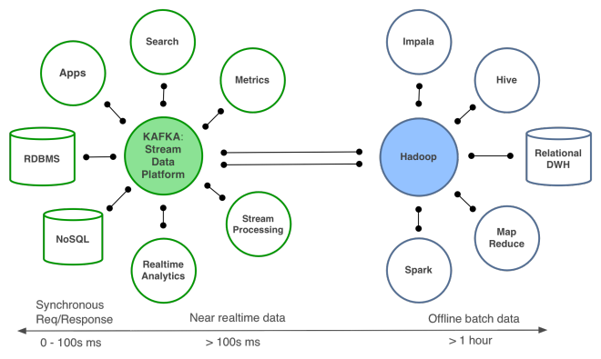
How Kafka fits into real-time processing ?
It is a distributed message bus.
Main use is reliable message delivery in architectures that require consuming high rates of events
It does not provide functionality to transform, alert on, or count data.
Kafka is often a key part of many architectures that involve stream processing.
Kafka provides a reliable stream of messages as the data source for Spark Streaming or Storm.

Slide 15
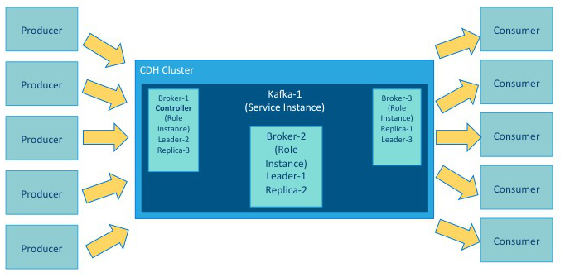
Kafka Components Over View
Kafka service is an application that runs in a CDH cluster.
A role is a feature of a service. A broker is a role in a Kafka service.
A topic is a category of records that share similar characteristics.
A cluster can include multiple roles and multiple instances of the same role. A service instance might be Kafka-1. Kafka-1 might host the role instances Broker-1, Broker-2 and Broker-3
A producer is an external process that sends records to a Kafka topic. A consumer is an external process that receives topic streams from a Kafka cluster.

Slide 16
Introduction to Spark
What is In-Memory Computing
Real Time Processing
What is Spark
History of Spark
Spark Architecture
Spark Shell
Spark Context
Q&A

Slide 17
What is Spark?
Apache Spark is a lightning-fast cluster computing technology, designed for fast computation. It is based on Hadoop MapReduce and it extends the MapReduce model to efficiently use it for more types of computations, which includes interactive queries and stream processing. The main feature of Spark is its in-memory cluster computing that increases the processing speed of an application.
Spark is not a modified version of Hadoop and is not, really, dependent on Hadoop because it has its own cluster management. Hadoop is just one of the ways to implement Spark.
Spark uses Hadoop in two ways – one is storage and second is processing. Since Spark has its own cluster management computation, it uses Hadoop for storage purpose only.
In MapReduce, the highest-level unit of computation is a job. A job loads data, applies a map function, shuffles it,applies a reduce function, and writes data back out to persistent storage. In Spark, the highest-level unit of computation is an application. A Spark application can be used for a single batch job, an interactive session with multiple jobs, or a long-lived server continually satisfying requests. A Spark job can consist of more than just a single map and reduce.
MapReduce starts a process for each task. In contrast, a Spark application can have processes running on its behalf even when it's not running a job. Furthermore, multiple tasks can run within the same executor. Both combine to enable extremely fast task startup time as well as in-memory data storage, resulting in orders of magnitude faster performance over MapReduce.

Slide 18
What is Spark?
Spark is the open standard for flexible in-memory data processing for batch, real-time, and advanced analytics.
Powerful open source processing engine built around speed, ease of use, and sophisticated analytics.
First high-level programing language for fast, distributed data processing.
Some key points about Spark:
handles batch, interactive, and real-time within a single framework
native integration with Java, Python, Scala
programming at a higher level of abstraction
more general: map/reduce is just one set of supported constructs
Can use Spark to process data that is destined for Hbase
Can also use Spark in conjunction with Apache Kafka to stream data from Spark to HBase

Slide 19
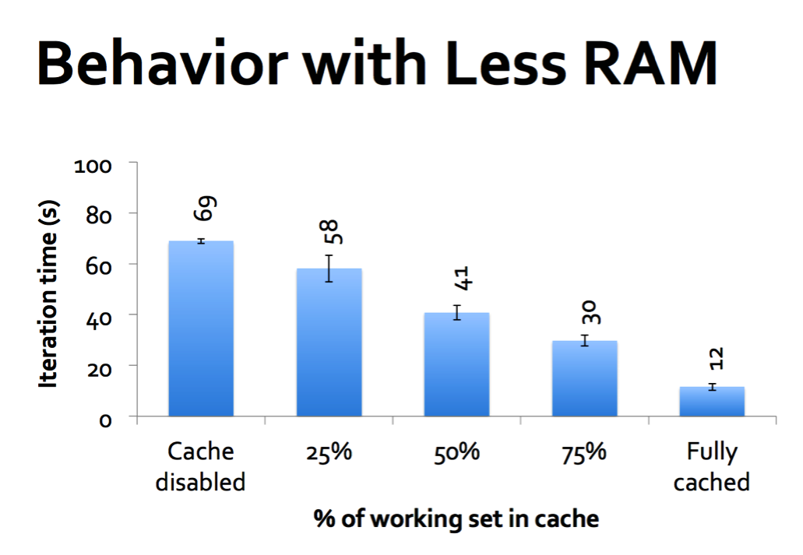
What is Spark - (Cont) ?
A distributed computing platform designed to be
Fast
Fast to develop distributed applications
Fast to run distributed applications
Spark is designed to cover a wide range of workloads
Batch applications.
Iterative algorithms.
Interactive queries.
streaming.

Slide 20
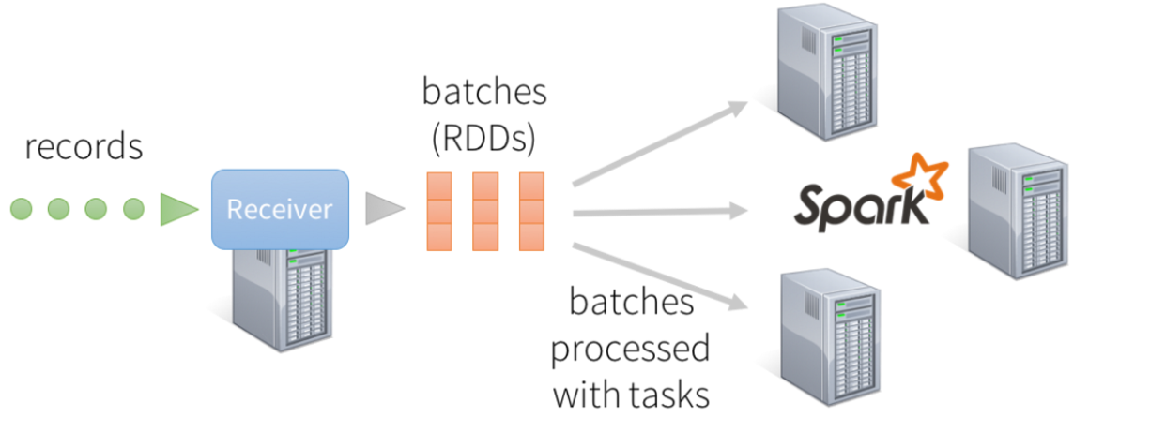
What is Spark - (Cont)?
Fast/Speed
Computations in memory
Faster than MR even for disk computations
Generality
Designed for a wide range of workloads
Single Engine to combine batch, interactive, iterative, streaming algorithms.
Has rich high-level libraries and simple native APIs in Java, Scala and Python.
Reduces the management burden of maintaining separate tools
Image Source: https://databricks.com/wp-content/uploads/2015/07/image21-1024x734.png

Slide 21
Introduction to Spark
What is In-Memory Computing
Real Time Processing
What is Spark
History of Spark
Spark Architecture
Spark Shell
Spark Context
Q&A

Slide 22
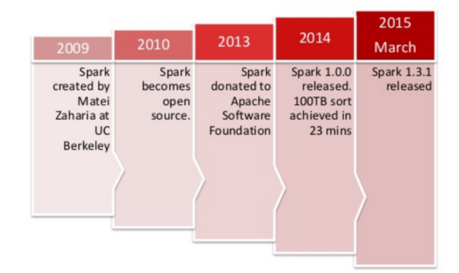
History of Spark
Started in 2009 as a research project in UC Berkeley RAD lab which became AMP Lab.
Spark was open sourced in March 2010 and transformed into Apache Foundation project in June 2013
Image Source: Developer Summit

Slide 23
Introduction to Spark
What is In-Memory Computing
Real Time Processing
What is Spark
History of Spark
Spark Architecture
Spark Shell
Spark Context
Q&A

Slide 24
Spark Ecosystem
Spark SQL
Streaming
MLlib
GraphX
Spark Core API
R
SQL
Python
Scala
Java

Slide 25
Spark Streaming
Running on top of Spark, Spark Streaming enables powerful interactive and analytical applications across both streaming and historical data, while inheriting
Uses the scheduling of the Spark Core for streaming analytics on mini batches of data.
Has a number of unique considerations such as the window sizes used for batches.
Running on top of Spark, it enables powerful interactive and analytical applications across both streaming and historical data, while inheriting Spark’s ease of use and fault tolerance characteristics.
Readily integrates with a wide variety of popular data sources, including HDFS, Flume, Kafka, and Twitter.

Slide 26














Spark Architecture
Spark SQL
Spark
Streaming
GraphX
Packages
MLlib
YARN
DataFrame API
Standalone
Spark Core
Data Sources
26

Slide 27
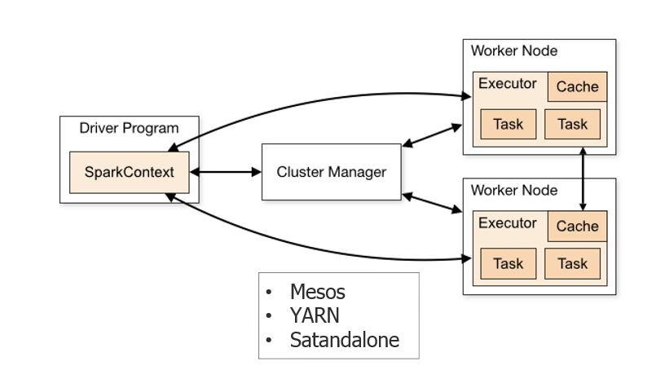
Spark Architecture
Spark Cluster
Image Source: http://spark.apache.org/docs/latest/cluster-overview.html

Slide 28
Spark Architecture
Spark Cluster : Components
Driver program | The process running the main() function of the application and creating the SparkContex
Cluster manager | An external service for acquiring resources on the cluster (e.g. standalone manager, Mesos, YARN)
Worker node | Any node that can run application code in the cluster
Executor | A process launched for an application on a worker node, that runs tasks and keeps data in memory or disk storage across them. Each application has its own executors.

Slide 29
Introduction to Spark
What is In-Memory Computing
Real Time Processing
What is Spark
History of Spark
Spark Architecture
Spark Shell
Spark Context
Q&A

Slide 30
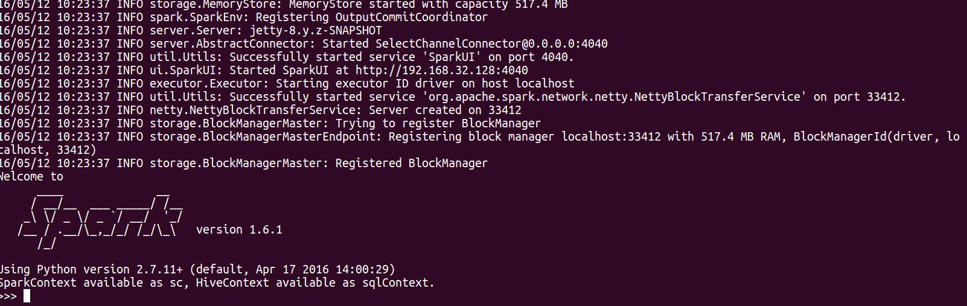
Spark Shell
Spark’s shell provides a simple way to learn the API
PySpark shell : Use below command to open the shell
Python shell: $bin/pyspark
Scala Shell: $bin/spark-shell
Notes:
The first step is to open up one of Spark’s shells. To open the Python version of the Spark shell, which we also refer to as the PySpark Shell, go into your Spark directory and type: bin/pyspark
To open the Scala version of the shell, type: bin/spark-shell

Slide 31
Spark Shell
Spark’s shell provides a simple way to learn the API
Python
>>> lines = sc.textFile("README.md") # Create an RDD called lines
>>> lines.count() # Count the number of items in this RDD
127
>>> lines.first() # First item in this RDD, i.e. first line of README.md
u'# Apache Spark'
Scala
scala> val lines = sc.textFile("README.md") // Create an RDD called lines
lines: spark.RDD[String] = MappedRDD[...]
scala> lines.count() // Count the number of items in this RDD
res0: Long = 127
scala> lines.first() // First item in this RDD, i.e. first line of README.md
res1: String = # Apache Spark
To exit either shell, press Ctrl-D

Slide 32
Introduction to Spark
What is In-Memory Computing
Real Time Processing
What is Spark
History of Spark
Spark Architecture
Spark Shell
Spark Context
Q&A

Slide 33
Spark Context
Initializing a SparkContext : Python
Creating a SparkConf object to configure your application
Initializing Spark in Python
from pyspark import SparkConf, SparkContext
conf = SparkConf().setMaster("local").setAppName("My App")
sc = SparkContext(conf = conf)
Notes:
• A cluster URL, namely local in these examples, which tells Spark how to connect
to a cluster. local is a special value that runs Spark on one thread on the local
machine, without connecting to a cluster.
• An application name, namely My App in these examples. This will identify your
application on the cluster manager’s UI if you connect to a cluster.

Slide 34
Spark Context
Initializing a SparkContext : Scala
import org.apache.spark.SparkConf
import org.apache.spark.SparkContext
import org.apache.spark.SparkContext._
val conf = new SparkConf().setMaster("local").setAppName("My App")
val sc = new SparkContext(conf)
Notes:
• A cluster URL, namely local in these examples, which tells Spark how to connect
to a cluster. local is a special value that runs Spark on one thread on the local
machine, without connecting to a cluster.
• An application name, namely My App in these examples. This will identify your
application on the cluster manager’s UI if you connect to a cluster.

Slide 35
Q & A

Slide 36
Thank You
Review Date | 12-May-2016
Version | 1.0
Next Review Due | 12-May-2016

